Slide 1
Exploratory Data Analysis: Summaries and Visual Structure
Chapter 4
Built from current L3 EDA slides 13-33

Slide 2
Single Number Summary Statistics
Ways to characterize the entire distribution of a dataset variable into one number that answers a specific question about the data’s behavior.
Measures of Center
Measures of Spread
Measures of Shape
Measures of Extremes

Slide 3
Measures of Center
Mean: The center of mass, or “balance point.”
Sensitive to outliers.
Median: The middle value when data are ordered.
Robust to outliers.
Mode: The most common value.
Useful for categorical data.

Slide 4
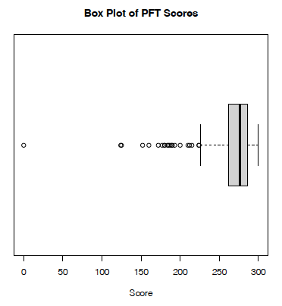
Measures of Spread
How variable are the data?
Range: Max – Min
Interquartile Range (IQR): $Q3−Q1$
Variance
Average squared deviation from the mean
Standard Deviation
Square root of variance
Useful for intuiting units of measure
Image source: EDA Example 3.5.2

Slide 5
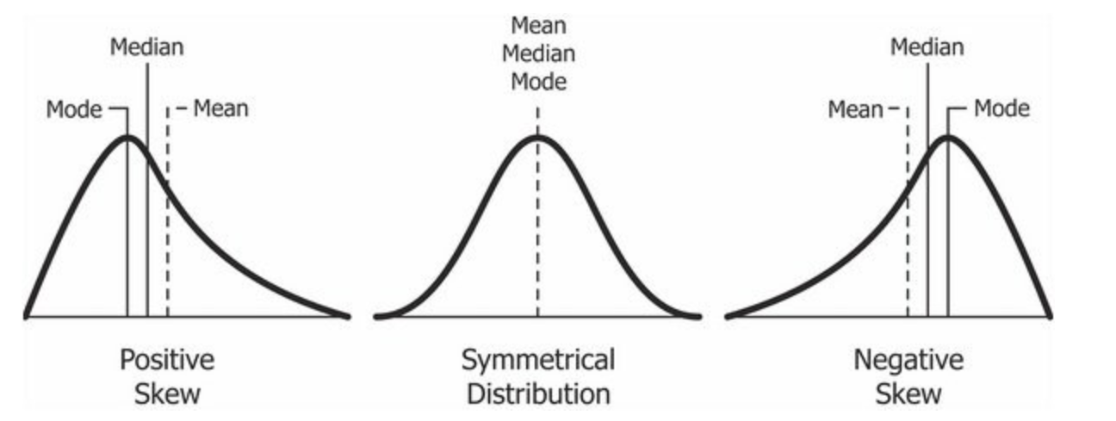
Measures of Shape
Third standardized central moment: Skewness
Informally: The directional tilt or asymmetry
Formally:
$$γ_{1}=\frac{𝔼\left[{\left(K−μ\right)}^{3}\right]}{σ^{3}}$$
Positive skewness – long / heavy right tail
Negative skewness – long / heavy left tail
Image source: Jain, D. “Relationship between mean and median under different skewness.png” CC BY SA-4.0.

Slide 6
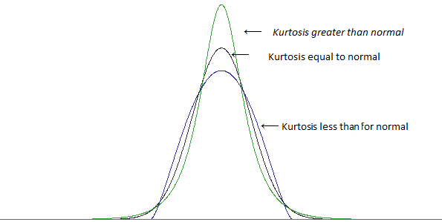
Measures of Shape
Fourth standardized central moment: Kurtosis
Informally: “Fatness” or tail weight
Formally:
$$γ_{2}=\frac{𝔼\left[{\left(K−μ\right)}^{4}\right]}{σ^{4}}$$
How much probability lives far from the mean
High kurtosis – more extreme values
Low kurtosis – fewer extremes
Excess Kurtosis: $γ_{2}−3$
Normal distribution has kurtosis 3
Image source: https://stats.stackexchange.com/questions/84158/how-is-the-kurtosis-of-a-distribution-related-to-the-geometry-of-the-density-fun

Slide 7
Nonparametric / Quantile Based Analogs
Some measures are more robust to outliers than others
Classical (moment-based) | Nonparametric (Quantile-based) | What it captures
Mean | Median | Center
Variance / SD | IQR | Spread
Skewness | Bowley Skewness $$Skew_{Q}=\left(\frac{Q_{3}+Q_{1}−2Q_{2}}{Q_{3}−Q_{1}}\right)$$ | Asymmetry
Kurtosis | Moors Kurtosis | Tail Weight

Slide 8
Measures of Extremes
Minimum
Maximum
Outlier Flags
Tukey fences: Named after John Tukey, who invented the box plot
Image source: EDA Example 3.5.2

Slide 9
Visual EDA
So far we have focused on numbers to summarize the observations of a variable.
Visual EDA uses plots as a powerful tool to show the behavior of these observations.
We will tie the single-number summary statistics to this behavior.

Slide 10
Visual EDA - Categories
Categorize visual EDA into three types, based on how many variables we examine:
Univariate Data – behavior of a single variable (distributions)
ex: ages, heights, service, communities
Bivariate Data – behavior of the relationships between two variables
ex: height vs weight
Multivariate Data –
Suggest interactions between two variables that affect a third
ex: effect of seniority and education on income
Patterns across many bivariate relationships at once
ex: Pairwise behaviors of height, weight, wingspan, and age

Slide 11
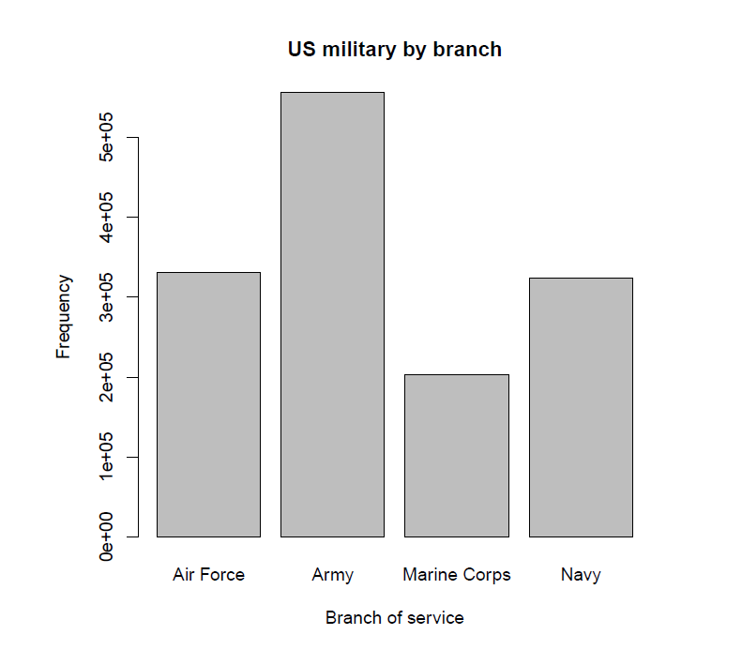
Univariate Data
Recommended plots per type of variable
Categorical data: Bar Plots
Numerical data: Histograms
Image source: EDA Example from the military dataset in the OIdata package (updated to the “openintro” package).

Slide 12
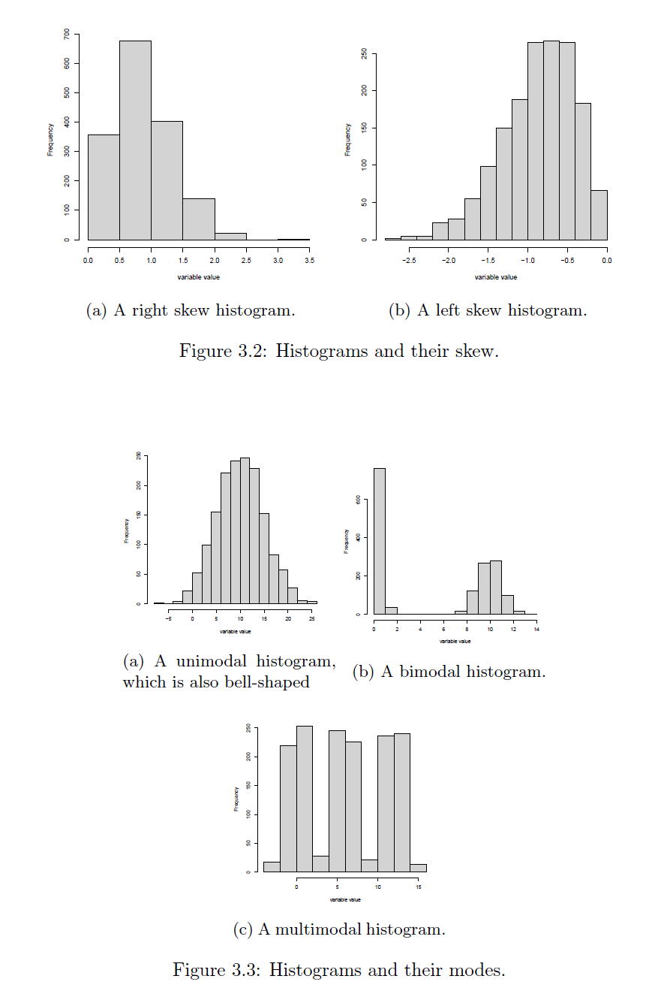
Histograms
Visually check:
Symmetry vs Skewness
Multimodality
Unimodal: single peak
Bimodal: two peaks
Multimodal: two or more peaks
Shape
Bell-shaped: Tells us what?
Image source: EDA Figures 3.2 and 3.3.

Slide 13
Applications of Standard Deviation
Empirical Rule:
If the histogram of a set of observations is bell-shaped, or approximately Gaussian (why would this happen?):
About 68% of observations lie within 1 standard deviation of the mean.
About 95% of observations lie within 2 standard deviations of the mean.
About 99.7% of the observations lie within 3 standard deviations of the mean.
Notes:
Bell curves show up for several reasons.
Sometimes it’s the Central Limit Theorem — many small additive effects.
- In physics, maximum entropy: if all we know is mean and variance, the most natural shape is the normal.
- Biology, symmetry and aggregation. The normal distribution is the ‘default’ shape of randomness.

Slide 14
Applications of Standard Deviation
What about when the data do not appear to be approximately normal?
We can generalize via Chebyshev’s Inequality:
For random variable $X$ with finite non-zero variance $σ^{2}$ and finite mean $μ$, for any real $k∈ℝ:$
$$P\left(\left|X−μ\right|≥kσ\right)≤\frac{1}{k^{2}}.$$
In (slightly more) English: For any $k>1$, at least $100\left(1−\frac{1}{k^{2}}\right)\%$ of the observations lie within $k$ standard deviations of the mean.

Slide 15
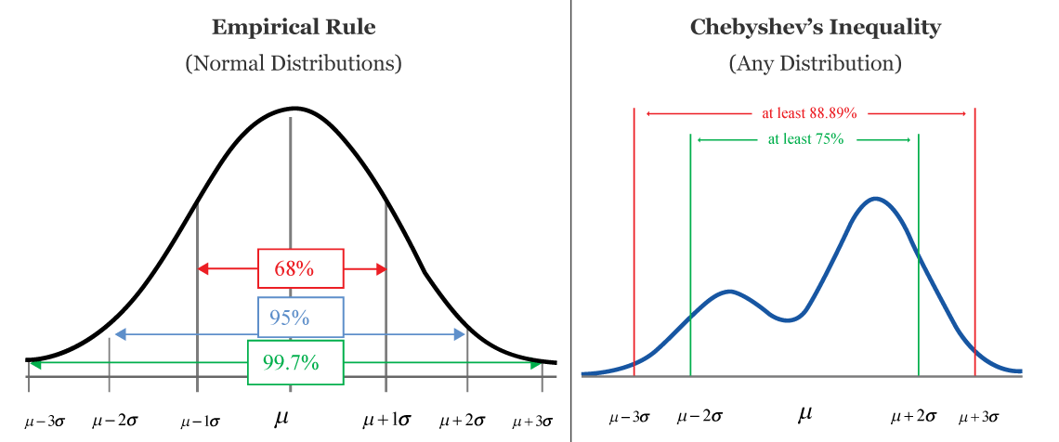
Applications of Standard Deviation
Empirical Rule gives us an approximate percentage of the data contained within a window of the mean.
Chebyshev gives a lower bound.
Image source: CalcWorkshop. Chebyshev’s Inequality. Retrieved from https://calcworkshop.com/joint-probability-distribution/chebyshev-inequality/

Slide 16
Bivariate Data
Examine the relationship between a pair of variables.
Recommended EDA plots by variable type $×$ variable type:
Data Types | Categorical / Ordinal | Numerical
Categorical / Ordinal | Grouped Bar Plot | Grouped Box plot
Numerical | Grouped Box Plot | Scatter Plot

Slide 17
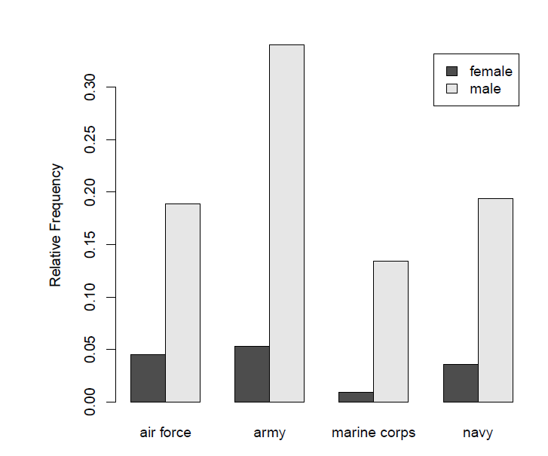
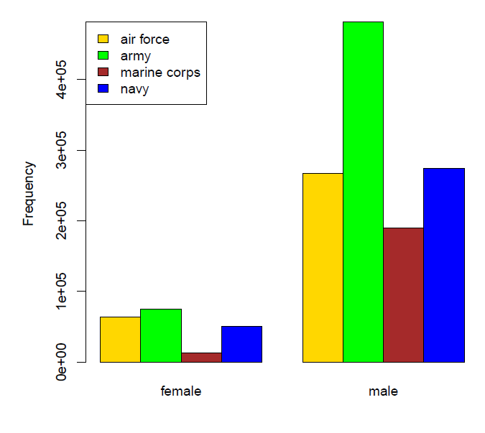
Grouped Bar Plots
Categorical / Ordinal $×$ Categorical / Ordinal
Image source: EDA Example from the military dataset in the OIdata package (updated to the “openintro” package).

Slide 18
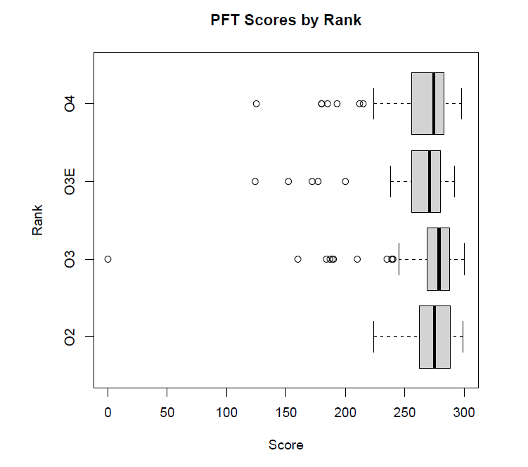
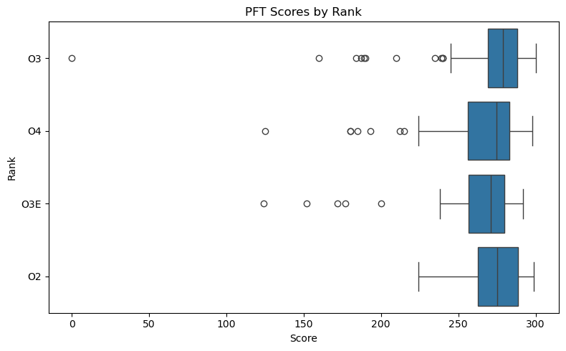
Grouped box plot
Categorical / Ordinal x Numerical
Image source: R (top) and Python/Seaborn (bottom) plots from the pft.csv dataset.

Slide 19
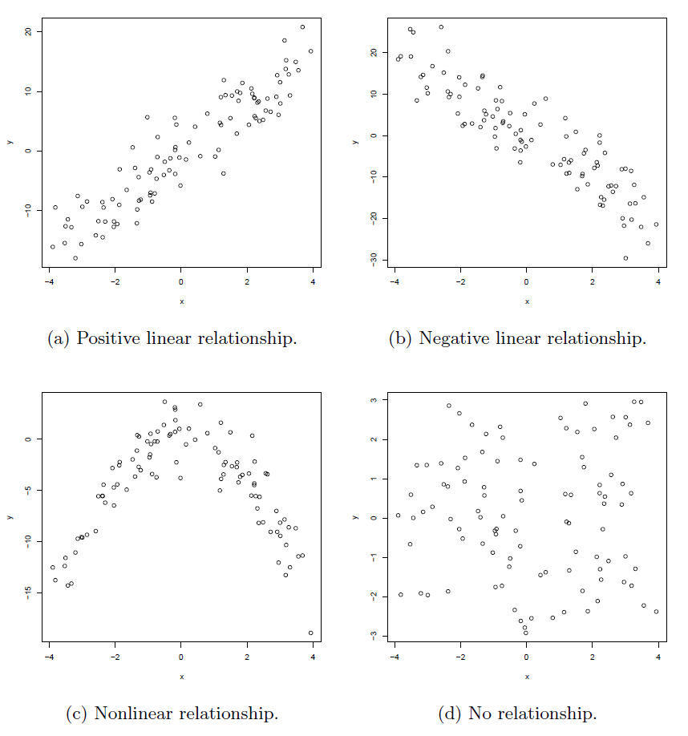
Scatterplots
Numerical $×$ Numerical
Image source: EDA Figure 3.8.

Slide 20
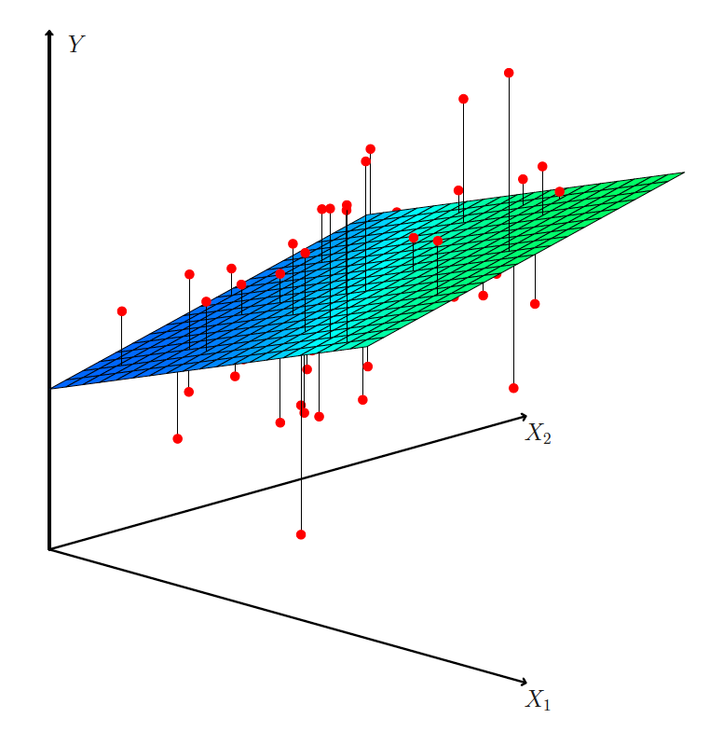
Multivariate Data
3d scatterplots
Scatterplot matrices
Correlation Heatmaps
Image source: ISLP Figure 3.4

Slide 21
Scatterplot matrices $→$ Correlation heatmaps
Not truly “multivariate”
Behavior of many variables together, often summarized through collections of pairwise relationships.
As the number of variables grows, pairwise plots become visually dense.
Heatmaps can summarize the same information more efficiently.

Slide 22
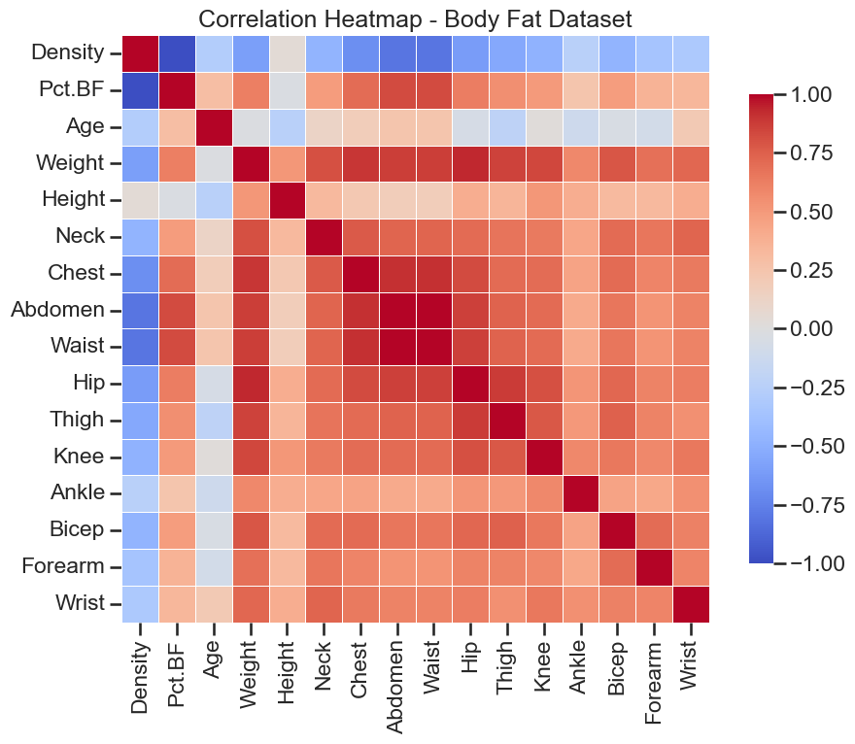
Correlation Heatmap
Recall from last week:
$$Cov\left(X,Y\right)=𝔼[\left(X−μ_{X}\right)\left(Y−μ_{Y}\right)]$$
Correlation $ρ_{XY}∈\left[−1,1\right]:$
$$ρ_{XY}=\frac{Cov\left(X,Y\right)}{\sqrt{Var\left[X\right]⋅Var[Y]}}$$
Why are the diagonal entries +1?

